Slide 1
MIPS Instruction-> Machine Instruction

Slide 2
How to Convert MIPS Instruction to Machine Language??
R-format used for Computational Category Instructions as
Computational Category-add/sub/and/or/nor
Shift Instructions-sll(Shift Left Logical )/srl(Shift Right Logical)

Slide 3
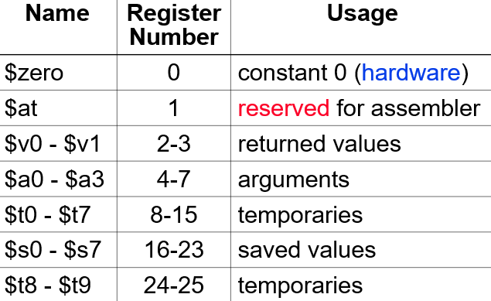
Register Conventions

Slide 4

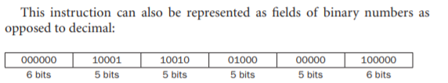
Given a MIPS add instruction…
Convert add $s0, $ s1, $s2 to Machine Language.
Machine Language In Hexadecimal Representation=(02324020)16

Slide 5
Revision Problem..
Convert sub $t0,$s1,$s2
Opcode=0 and Functional Code=34
Machine language in Hexa decimal Representation=(02324022)16

